Slide 1
Deep Learning Hands-on
Dr. Nanda Dulal Jana & Mr. Sandipan Dhar
Department of Computer Science and Engineering, NIT-Durgapur
Mail id: nandadulal@cse.nitdgp.ac.in, sd.19cs1101@phd.nitdgp.ac.in
Google site link: https://sites.google.com/phd.nitdgp.ac.in/sandipan-dhar/home

Slide 2
Contents:
Environment Setup
Basics of Preprocessing
Basics of Convolutional Neural Network (CNN)
CNN for medical imaging
CNN in speech processing
Some ongoing advancements in deep learning

Slide 3



Environment Setup
Notebooks or IDE ( integrated development environment) for DL program execution

Slide 4
Installation of notebooks or IDE ( integrated development environment) for DL program execution
Anaconda : https://www.anaconda.com/products/distribution
Anaconda installation guide: https://www.youtube.com/watch?v=YU7ZGgPKSsA
Jupyter Notebook: https://jupyter.org/
Jupyter Notebook installation guide: https://www.youtube.com/watch?v=kf3AwEvNdno
Pycharm: https://www.jetbrains.com/pycharm/download/#section=windows
Pycharm installation guide: https://www.youtube.com/watch?v=15daSz2QExo&t=422s

Slide 5




Slide 6
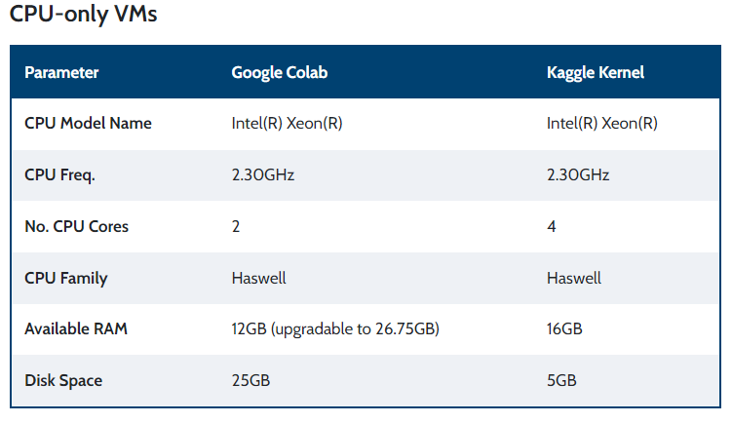
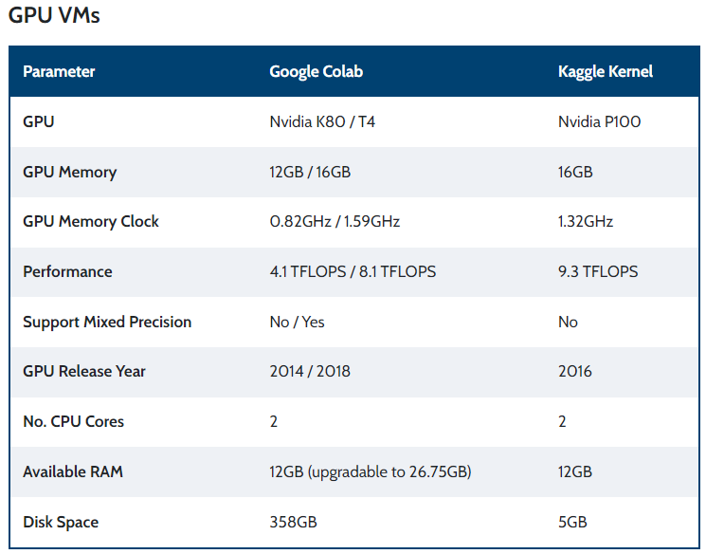
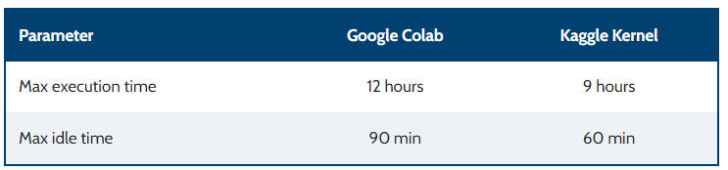

Slide 7
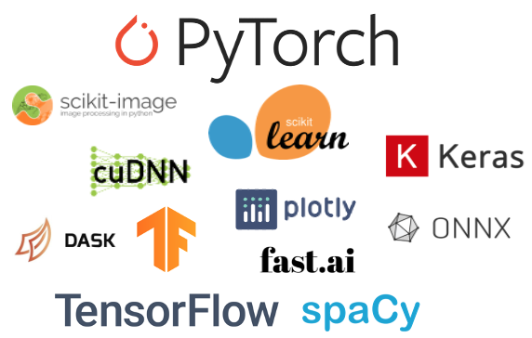
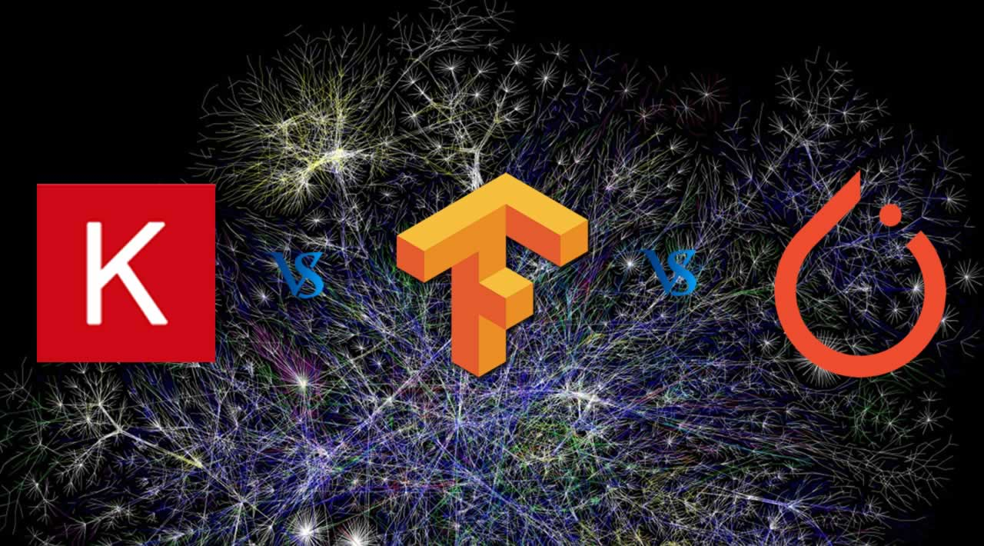
Deep Learning Frameworks

Slide 8

How to install python libraries in Google Colab
Goto this link: https://github.com/SandyPanda-MLDL/Deep-Learning-Demo
Or else this link:https://drive.google.com/drive/folders/1r_tYFqNUjQTDg6Wus8G5fv8U8AMsdaLX?usp=sharing

Slide 9
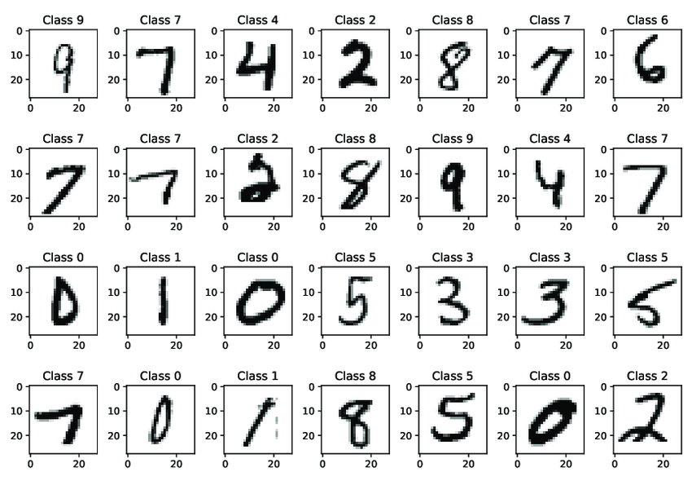
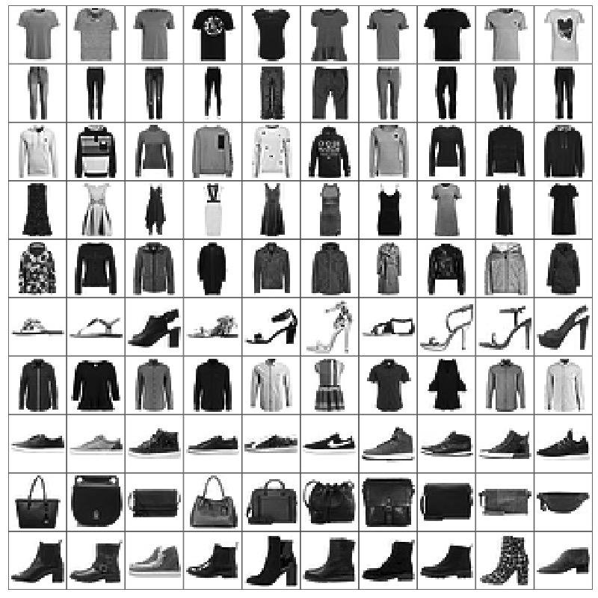
MNIST Dataset
60,000 examples in the training dataset and 10,000 in the test dataset and that images are indeed square with 28×28 pixels grayscale image.
training set of 60,000 examples and a test set of 10,000 examples. Each example is a 28x28 grayscale image, associated with a label from 10 classes.
MNIST Handwritten digits
Fashion MNIST
Class labels for each products https://www.tensorflow.org/tutorials/keras/classification
Link of official site of MNIST: http://yann.lecun.com/exdb/mnist/ https://conx.readthedocs.io/en/latest/MNIST.html

Slide 10
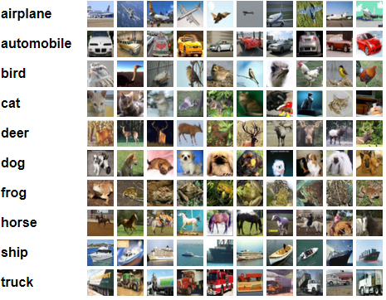
CIFAR 10 dataset
CIFAR-10 dataset consists of 60000 32x32 colour images in 10 classes, with 6000 images per class. There are 50000 training images and 10000 test images.
CIFAR 10 dataset official link: https://www.cs.toronto.edu/~kriz/cifar.html

Slide 11
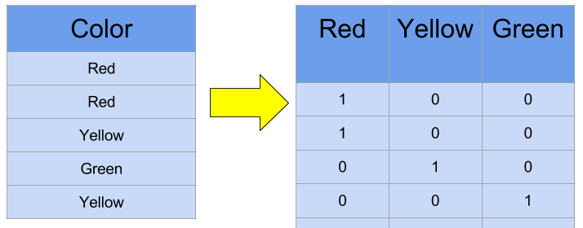
One-hot Encoding

Slide 12
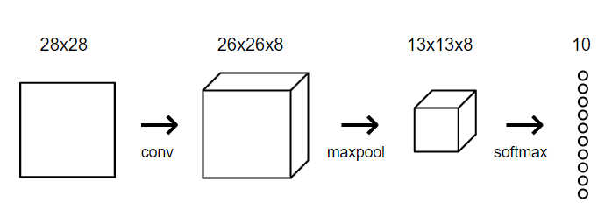
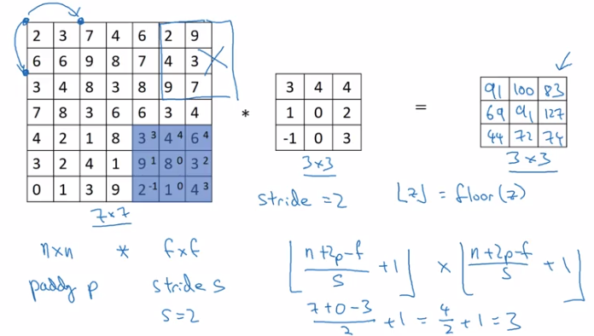
Implementation of DL model in Keras
In max pooling filter size is 2*2
Output of 1st Conv 26*26
The output of max pooling= 26/2 * 26/2
=13*13

Slide 13
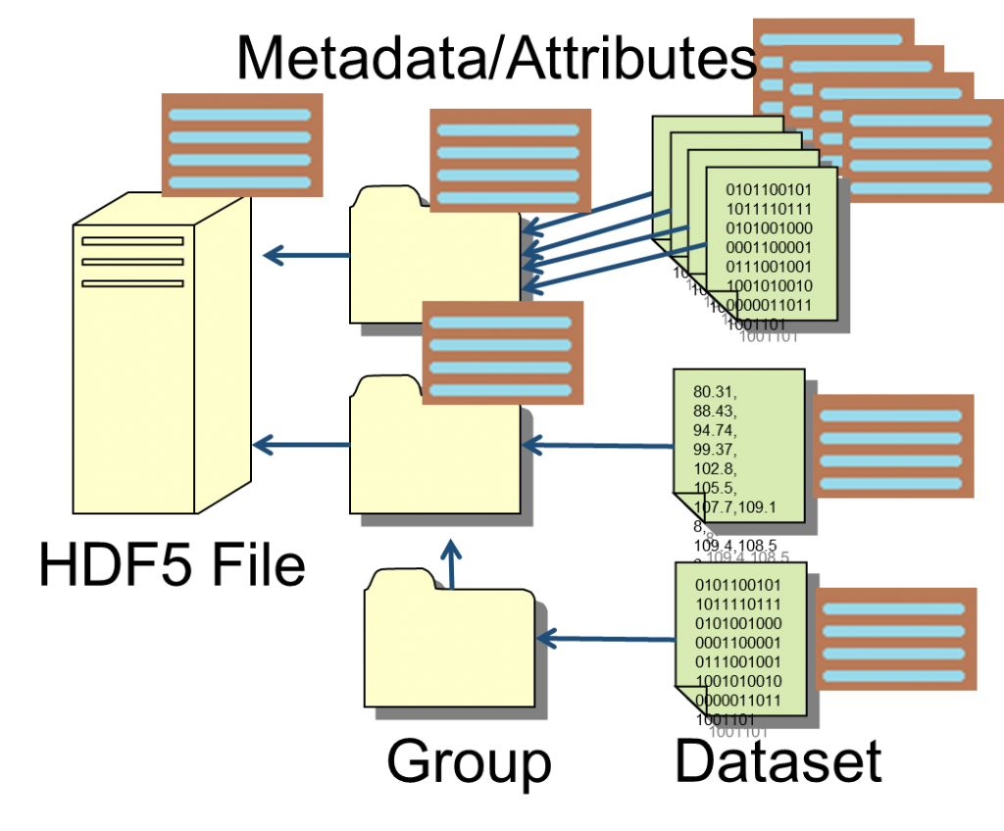
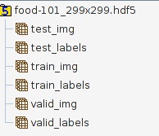
Hdf5 file format

Slide 14
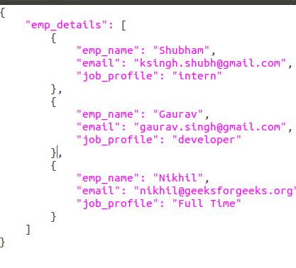

JSON file format

Slide 15

K-fold cross validation

Slide 16
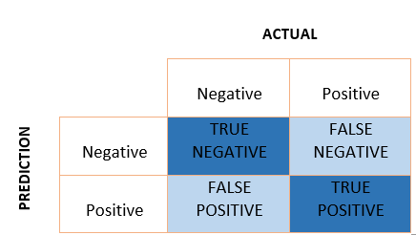
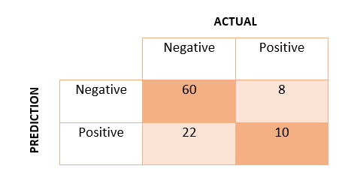
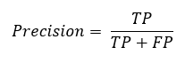
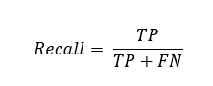
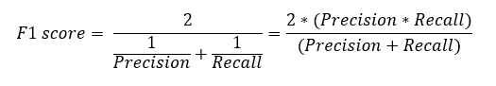
Customization of DL modules and evaluation metrics and all
My medium blog link: https://medium.com/@sandipandhar_6564/deep-learning-dem-6228e73377ff

Slide 17
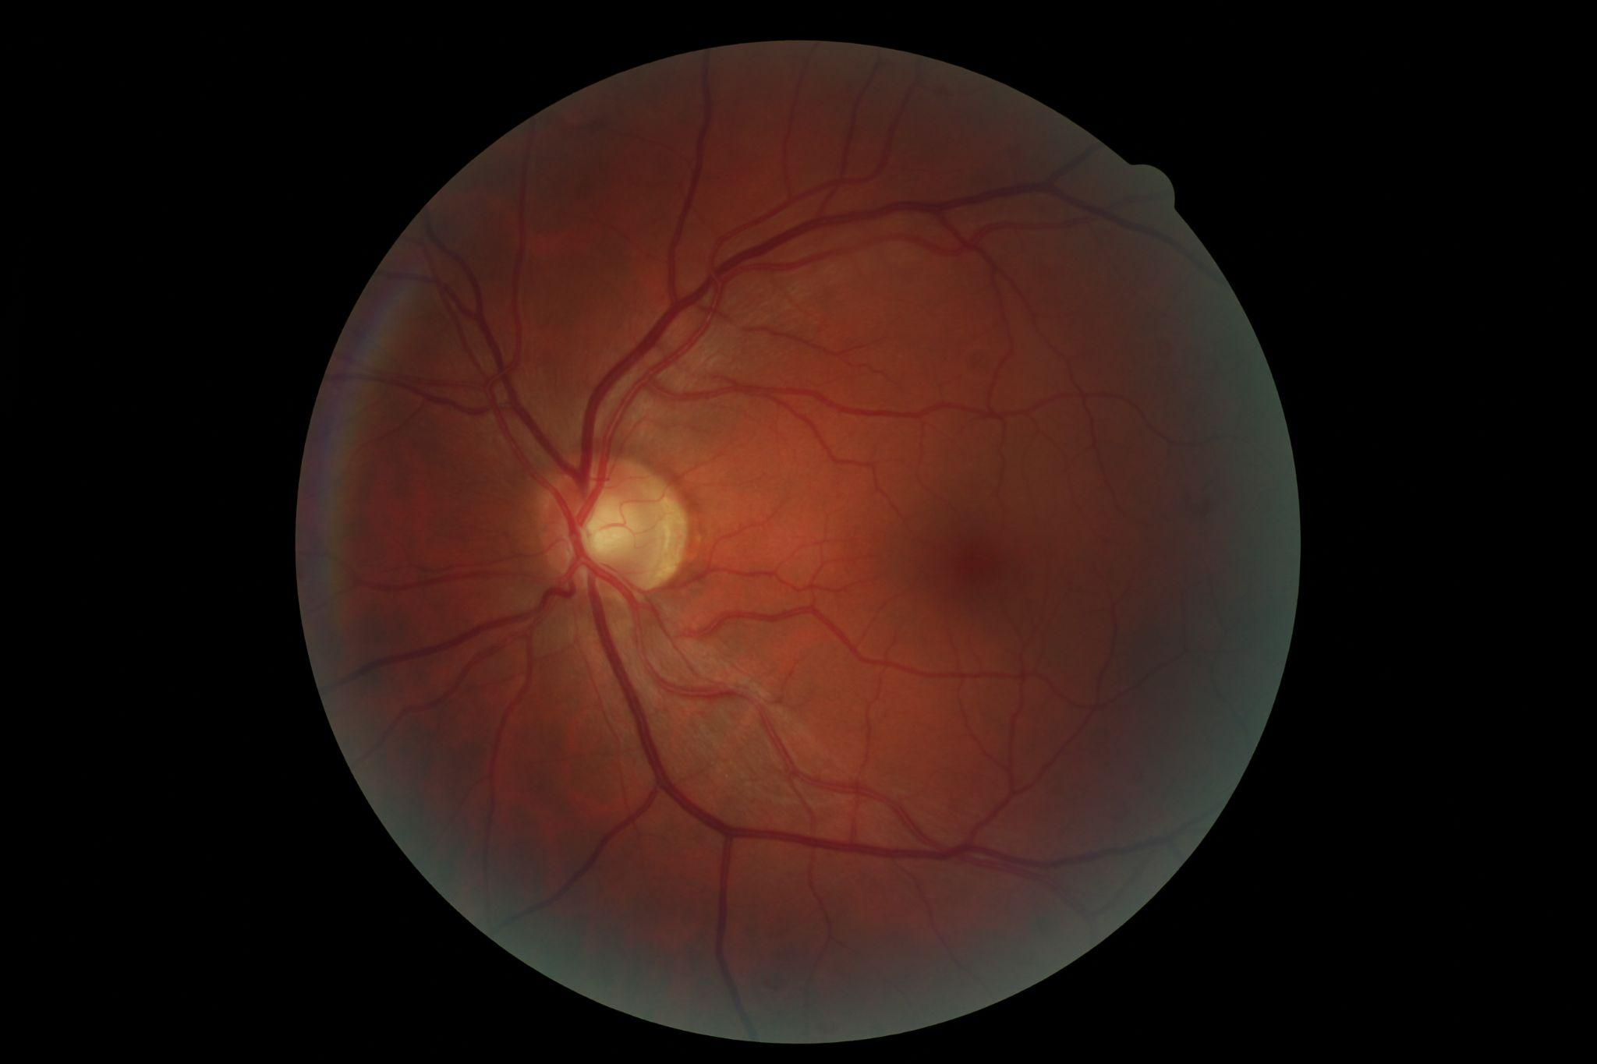
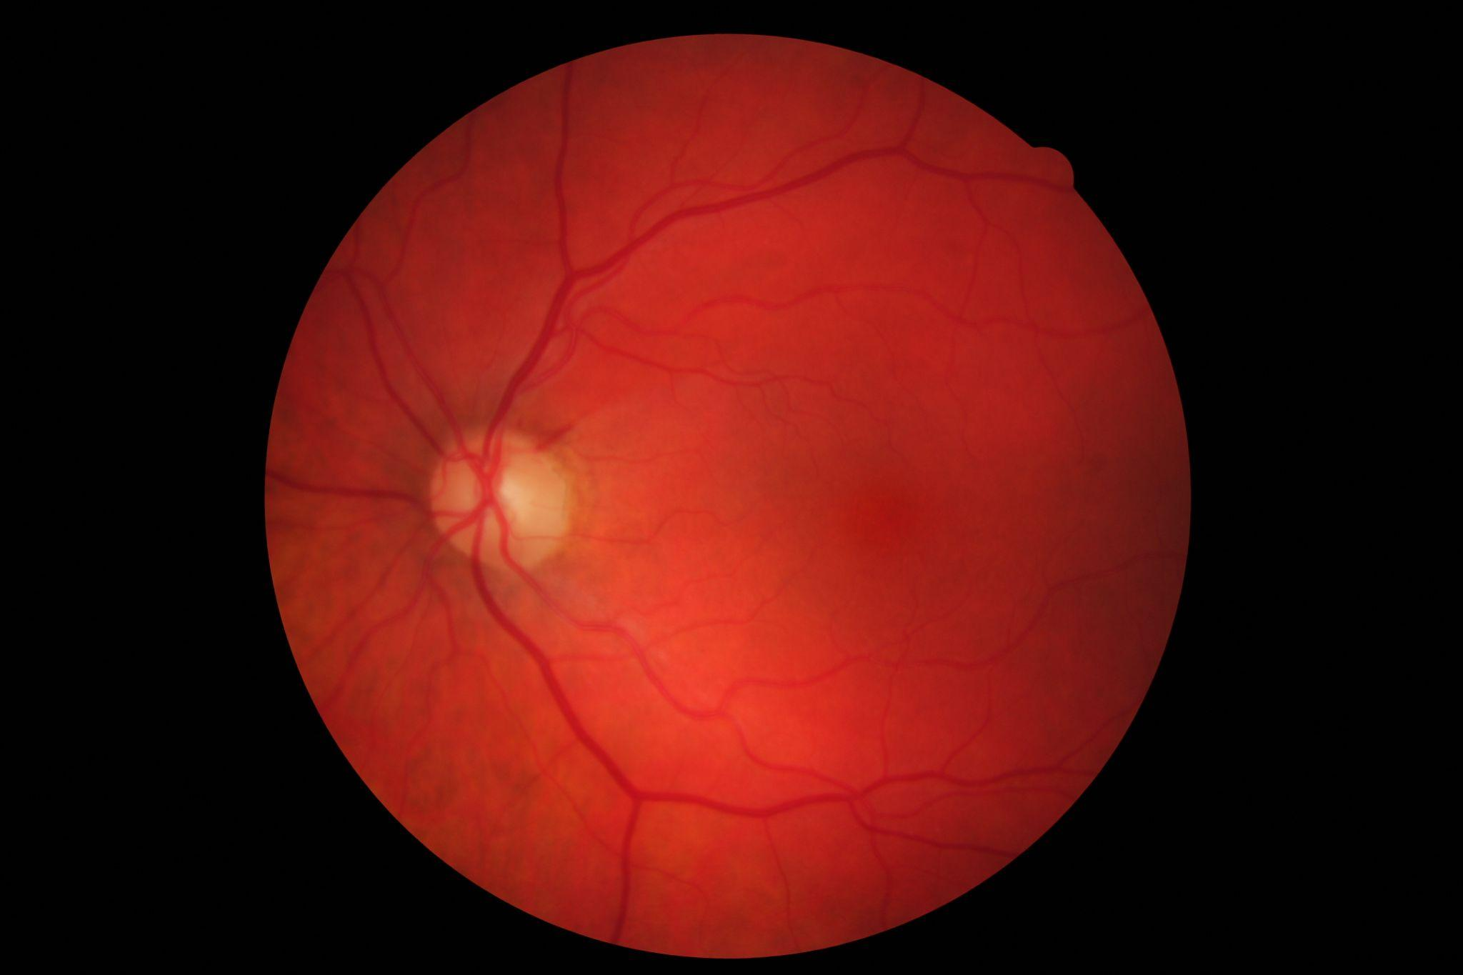
Deep Learning in Medical Imaging
Download the age macular disease dataset from my github repo link: https://github.com/SandyPanda-MLDL/Deep-Learning-Demo
Or
from my Google drive directly: https://drive.google.com/drive/folders/1Ghs1YmMdTOdZxHCfaqUaoQPNG79_9GJu?usp=sharing
Label 0: Age Macular Disease
Label 1: Healthy Fundus Image

Slide 18
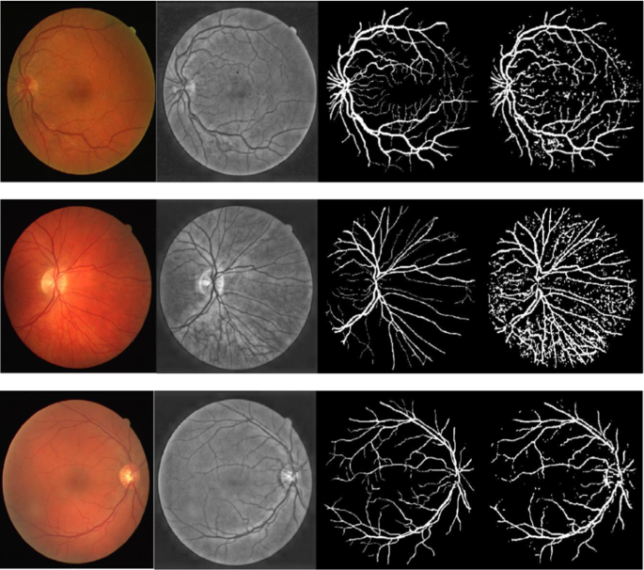
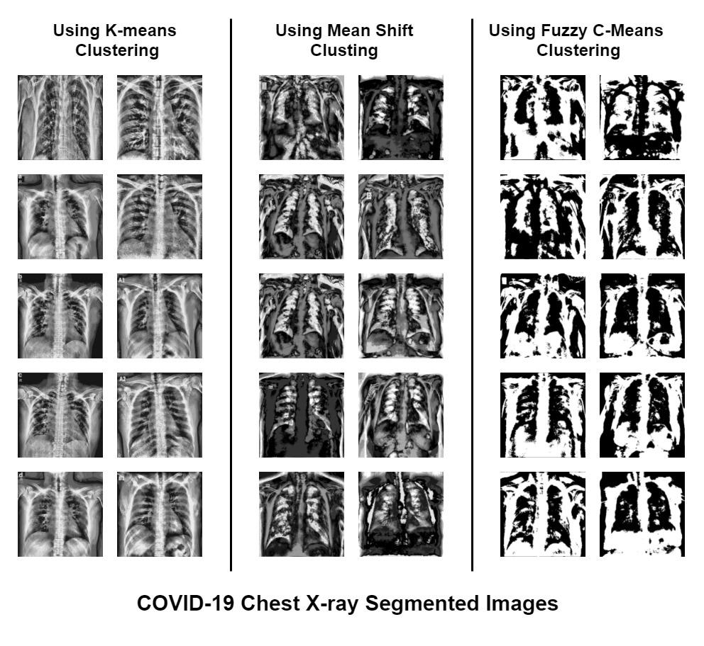
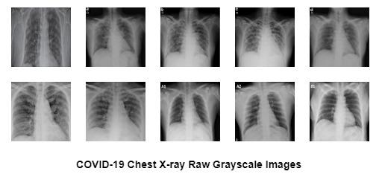
Preprocessing of medical images
Segmented images
Code: https://github.com/SukonyaPhukan92/COVID-19_Chest_X-ray_Image_Generation_using_ResNet50_and_DCGAN_Model
Lecture Notes in Networks and Systems, vol 430. Springer, Singapore.https://doi.org/10.1007/978-981-19-0825-5_24

Slide 19
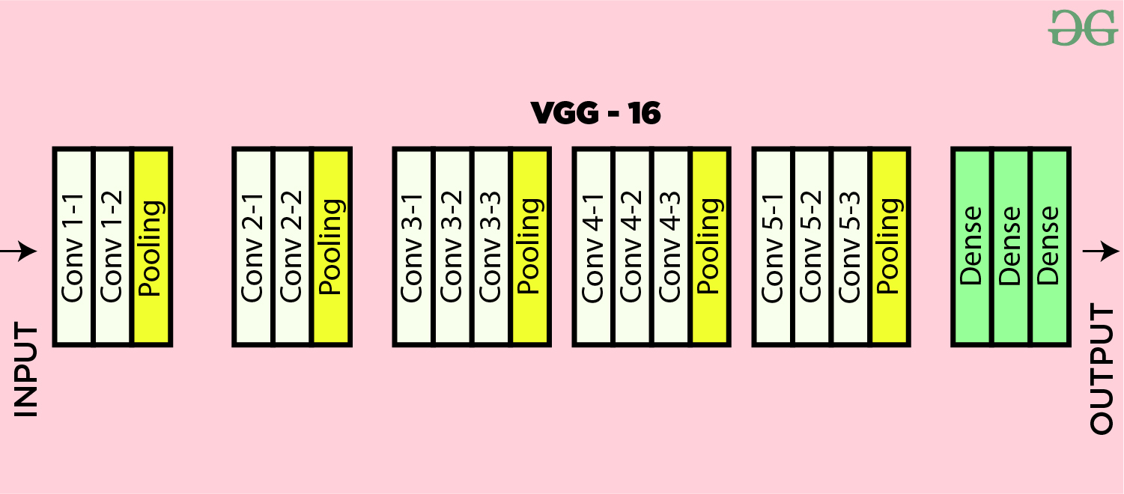
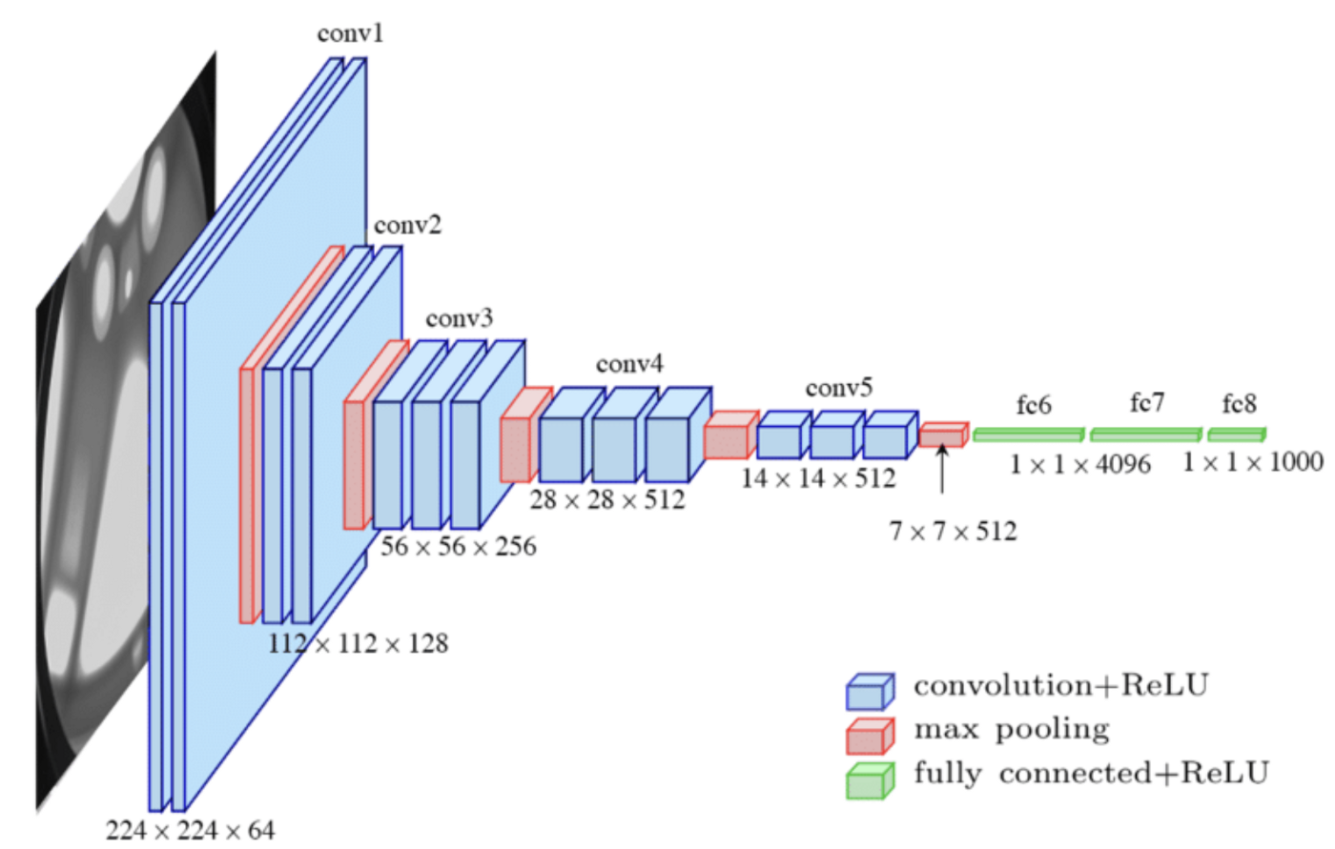
Google colab link: https://colab.research.google.com/drive/1ShC5kN_HhDEK63RRFqsLzf6squeHFPwS?usp=sharing
Or visit my repository: https://github.com/SandyPanda-MLDL/Deep-Learning-Demo
Keras.applications: https://keras.io/api/applications/

Slide 20
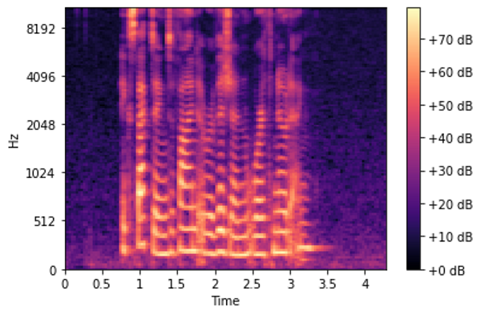
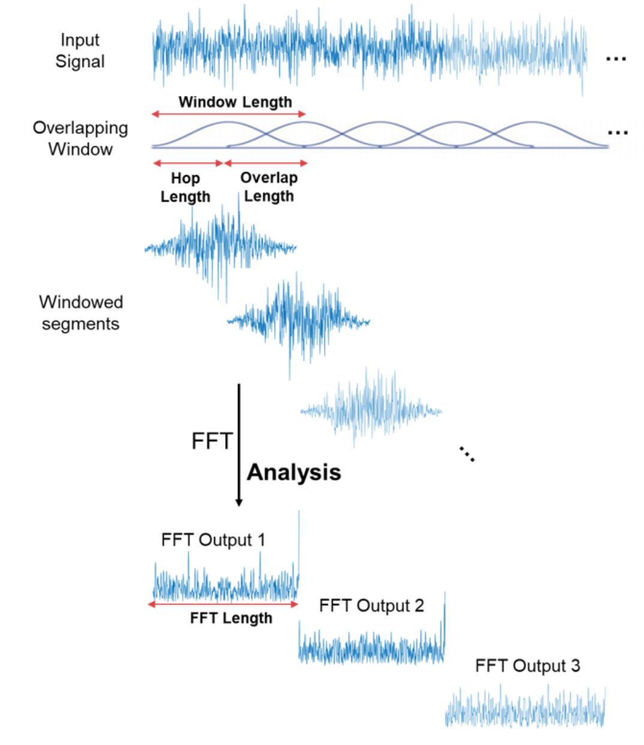
Deep Learning in Speaker Identification
Preprocessing
Mel-Spectrogram
To know more about Speech Processing visit my medium blog https://medium.com/@sandipandhar_6564/visualization-of-speech-data-f6504af6096c

Slide 21
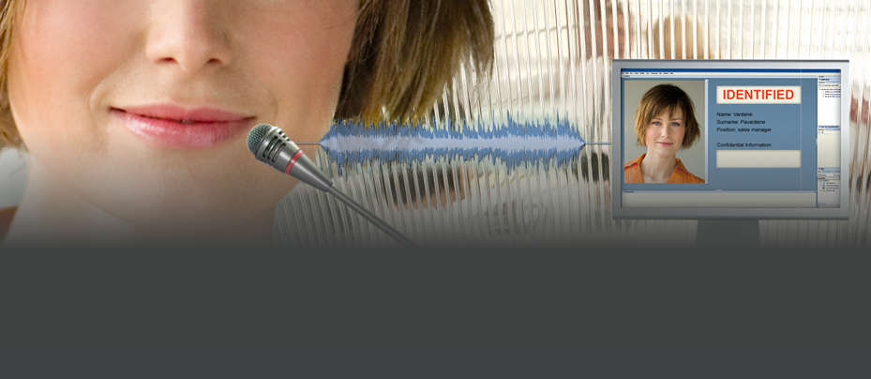
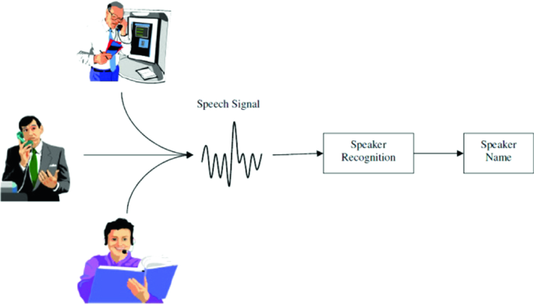
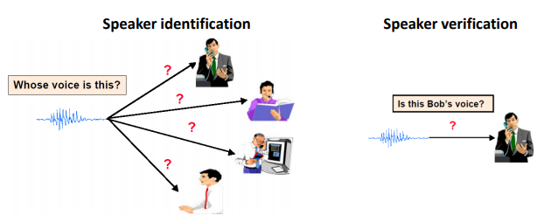
Speaker identification
multiclass classification and binary classification

Slide 22
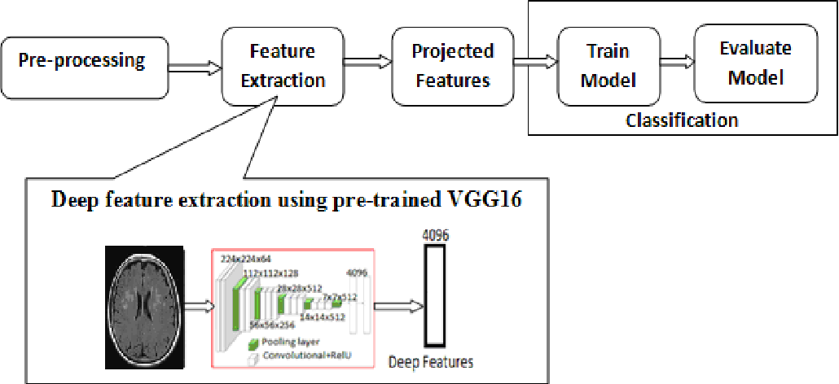
Latent feature from CNN
Dataset link: https://drive.google.com/drive/folders/1xZGxMIjAKJKe0wfGCvdIm2QbAJg2jeB6?usp=sharing
Code link forspeaker identification: https://colab.research.google.com/drive/117HnWX-XVGkPh-OVSV5L0o6G1DWmBChK?usp=sharing

Slide 23
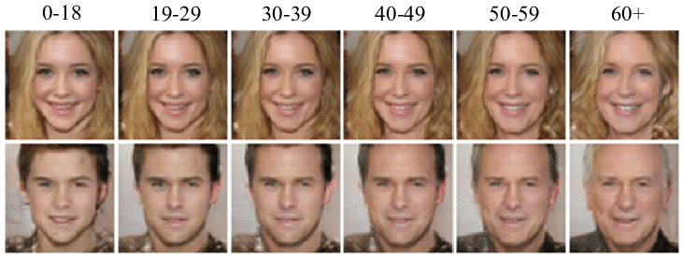
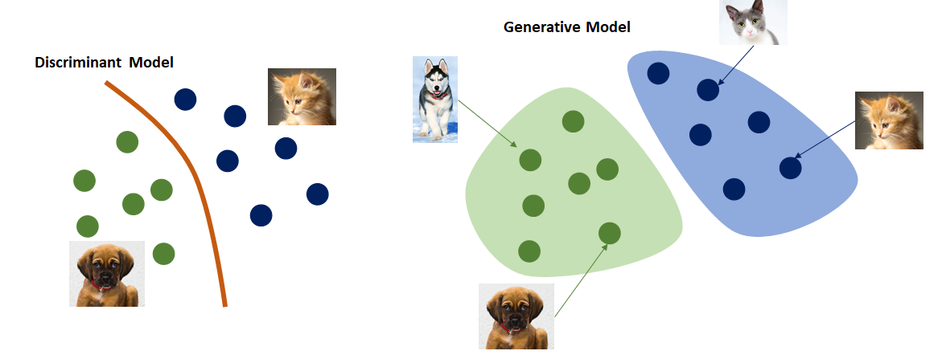
Some advancements
CNN as generative model
Generative Adversarial Network (GAN)

Slide 24
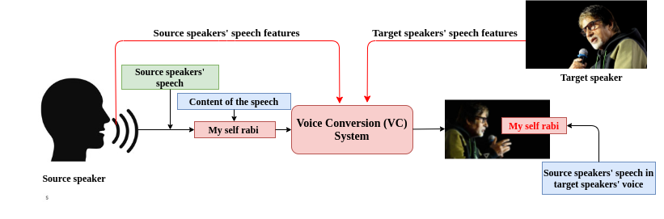
CNN as generative model for speech synthesis
My medium blog: https://medium.com/@sandipandhar_6564
ALGAN-VC: https://ieeexplore.ieee.org/document/9709124
S. Dhar, N. D. Jana and S. Das, "An Adaptive Learning based Generative Adversarial Network for One-To-One Voice Conversion," in IEEE Transactions on Artificial Intelligence, doi: 10.1109/TAI.2022.3149858.

Slide 25
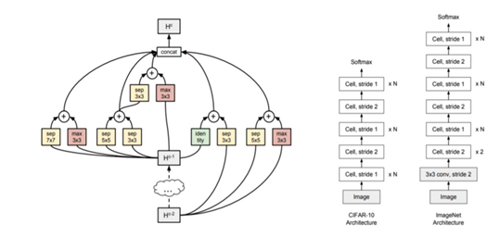
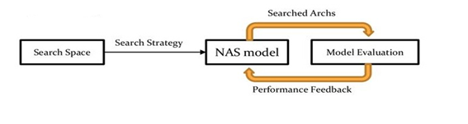
Neural Architecture Search for CNN models
Medium blog of Arjun Ghosh: https://medium.com/@csarjun49

Slide 26
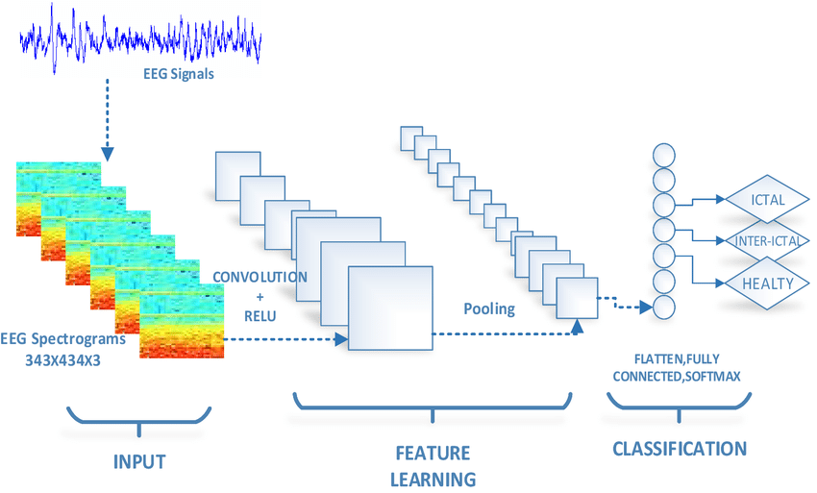
EEG signal classification using CNN

Slide 27
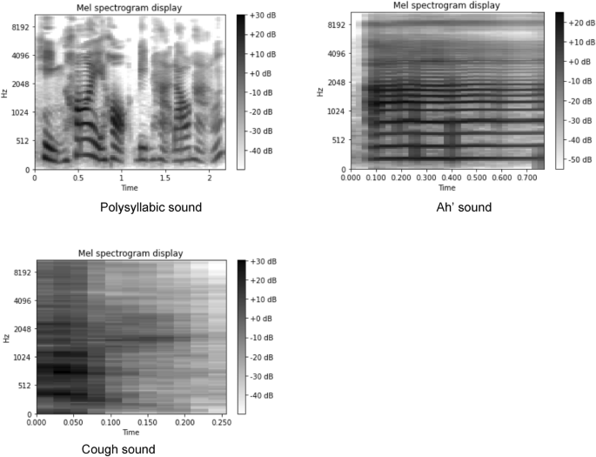
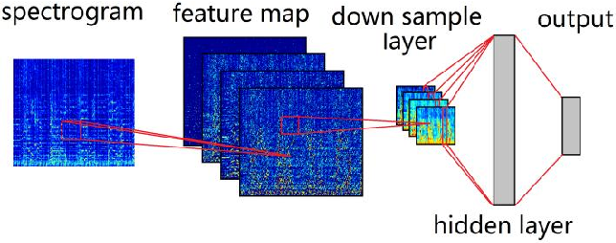
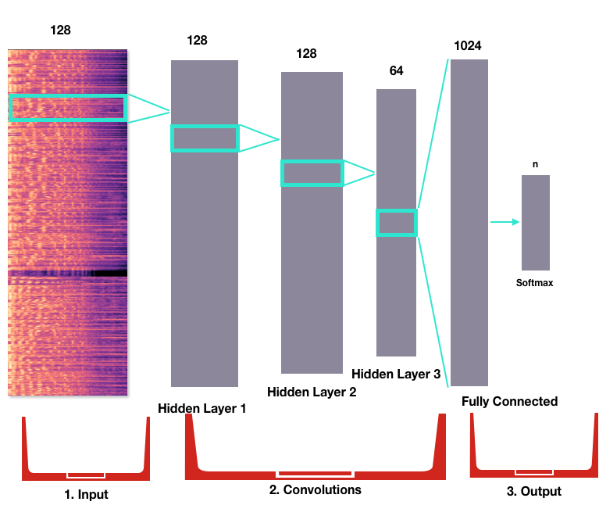
Speech disorder classification using CNN
Musical Data classification using CNN
And many more….

Slide 28
Thank You

